Slide 1
Big Mountain Resort Capstone Project

Slide 2
Problem Statement
How can Big Mountain Resort more fully capitalize on its facilities?
H
1
Context
4
Constraints within solution space
The Big Mountain business team wants some guidance on how to select a better value for their ticket price. They are also considering a number of changes that they hope will either cut costs without undermining the ticket price or will support an even higher ticket price.
Basing their pricing on just the market average does not provide the business with a good sense of how important some facilities are compared to others. This hampers investment strategy.
2
Criteria for success
5
Stakeholders to provide key insight
Increased revenue
Reduced cost
Remain the premium resort option
Director of Operations - Jimmy Blackburnand
Database Manager - Alesha Eisen
3
Scope of solution space
6
Key data sources
Increase ticket price (reflective of the recently installed chair lift)
Develop additional resort features (terrain park)
CSV datafile provided by the data manager
H
D
E
I
P
Notes:
Hypothesis: Create a Hypothesis with an emphasis on SMART principles. (S – Specific, M – Measurable, A – Achievable, R – Realistic, T – Timebound). If you cannot do this, you do not have a good grasp on the business problem.
Context: With context, we have clearly identified the problem at hand and have elucidated on how our initiative may solve this problem, alongside the commercial implications this will have on the business.
Criteria for Success: Clearly defining the criteria for success ensures that the scope of your work is clearly defined and understood. Otherwise, if this isn’t defined – your work will never end which will result in mismatched expectations.
Scope of Solution Space: Scoping out the solution space ensures that the business initiative is SPECIFIC for a certain segment or area. This prevents solutions that have been developed being scaled and applied for all other business units that the solution may not be responsible or scalable for.
Constraints within Solution Space: Looking forward, what are the foreseeable problems we are likely to encounter? Could this be stakeholder resistance? Could this be we don’t have access to the right data?
Stakeholders to provide key insight: Who are the people I need to speak to, to get the answers I need for my data analysis?
What key data sources are required?
Based off my discussions with the key stakeholders – can we clearly list out all the data sources we need so we can make a highly targeted request as opposed to a scatter-gun approach where we ask for a bit of everything?

Slide 3
Recommendations/Key Findings
With Big Mountain's current Adult Weekend ticket price at $81, our modelling suggests its facilities could support an increased price of $95.87. Even with an expected mean absolute value of $10.39, this suggests the resort has room for an increase.
Adding a new chair lift would increase operating costs but also support an increase in ticket price of $8.61. Regarding run closures, our model predicts closing one run would not affect ticket price support, and while closing 2 or 3 would reduce support, it may as well close 4 or 5 in that case as there would be no further loss in support.
It could be useful to have more price data about the resorts other than ticket price. It is possibly that Big Mountain is undervalueing other aspects of their faciilites and undercharging. While this model would be useful, one would have to gather more data to draw more comparisons.

Slide 4
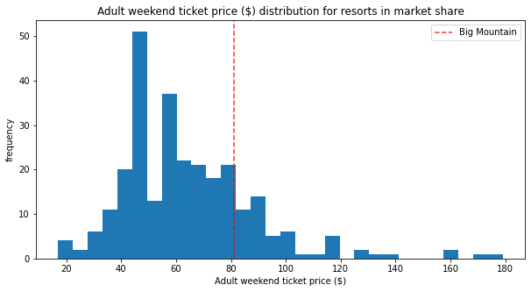
This graph shows that Big Mountain sits relatively high amongst all other resorts for Adult Weekend ticket price.

Slide 5
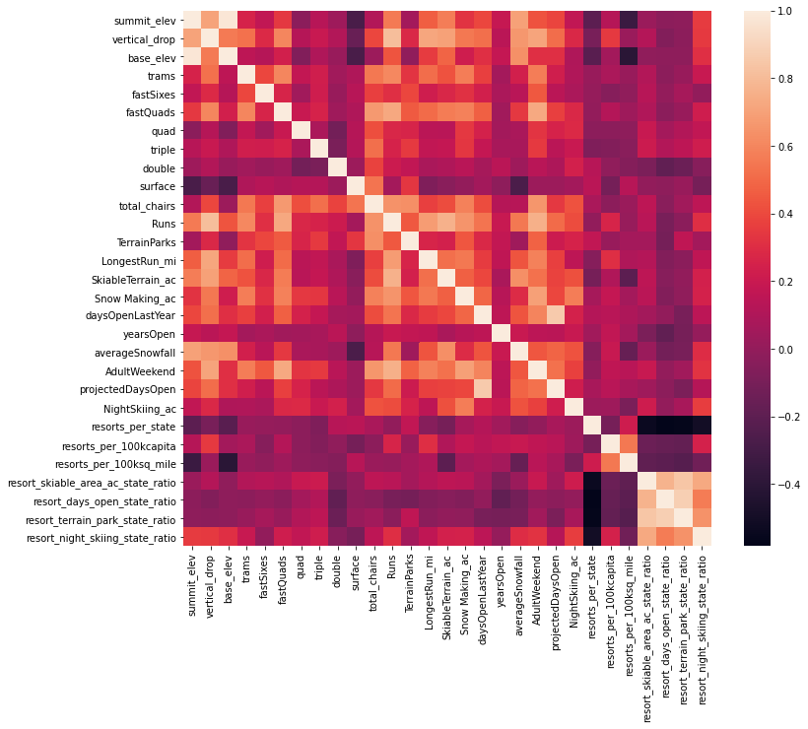
This heatmap shows that Adult Weekend ticket price tends to be strongly correlated with a resort’s number of fast quad chair lifts, runs, and amount of snow making.

Slide 6
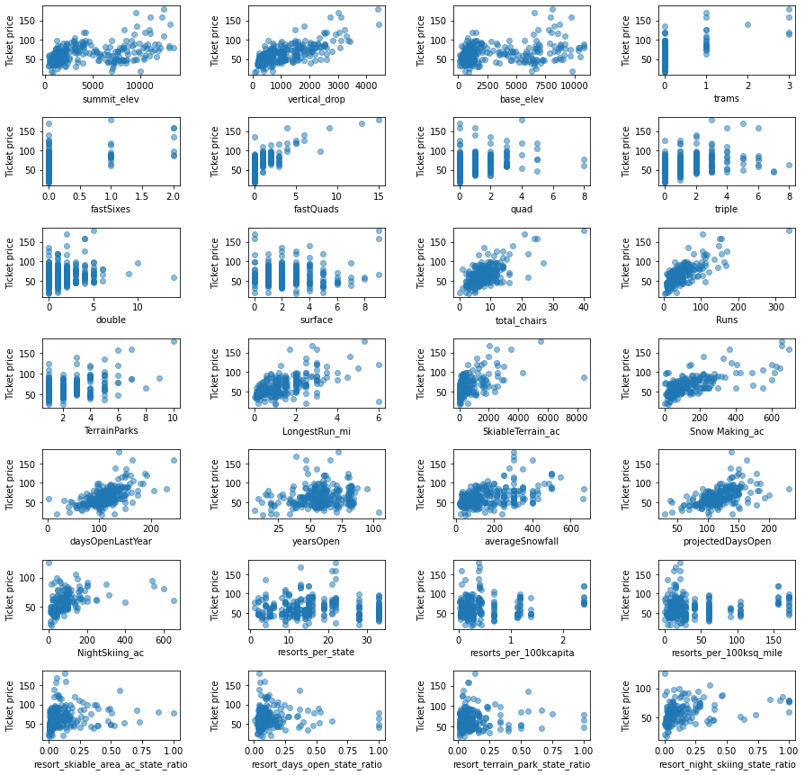
These scatterplots further show that Adult Weekend ticket price tends to be strongly correlated with a resort’s number of fast quad chair lifts, total chairs, runs, and vertical drop.

Slide 7
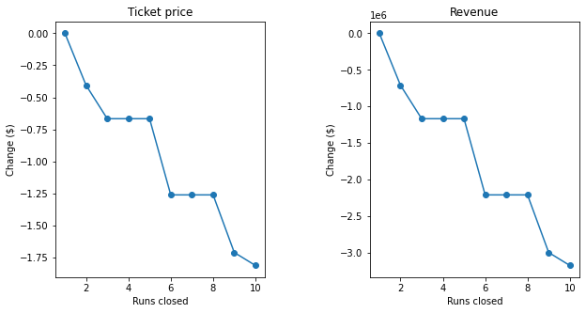
These graphs show the predicted results of run closures. Our model predicts closing one run would not affect ticket price support, and while closing 2 or 3 would reduce support, it may as well close 4 or 5 in that case as there would be no further loss in support.

Slide 8
Summary
We measured 277 resorts on 25 different factors to build a predictive model for ticket price. Through a series of tests we determined that the features most strongly correlated to Adult Weekend Ticket price were number of fast quads, runs, and amount of snow making. Our modelling suggests Big Mountain’s facilities could support an increased price of $95.87. Even with an expected mean absolute value of $10.39, this suggests the resort has room for an increase. The scenario of adding a new chair lift would increase operating costs but also support an increase in ticket price of $8.61. Regarding run closures, our model predicts closing one run would not affect ticket price support, and while closing 2 or 3 would reduce support, it may as well close 4 or 5 in that case as there would be no further loss in support.

